Slide 1
Large Language Models: ChatGPT
Data Science for Business
Joyce Yang
NYU Stern: Spring 2025

Slide 2
About Joyce
3rd year PhD candidate in Information Systems department
Undergraduate:
Computer Science and Mathematics
Master:
Computer Science
Research:
Computational Creativity
Interpretable Machine Learning
Fairness
Hobby:
Food, League of Legends, Skiing, Music …

Slide 3
Today’s Agenda
Review deep learning in text mining
Embedding
RNN vs. LSTM vs. Transformer
Pre-training; Fine-tuning
ChatGPT
Why is ChatGPT called ChatGPT? How to use ChatGPT？
The beauty of being Large!
Prompting Technique
What’s the mechanism of ChatGPT?
RLHF (Reinforcement Learning with Human Feedback)
Notes:
* I might talk a little bit in technical details, but don’t panic, it won’t be in your test. Just relax and enjoy.
Embedding is the foundation of AI word.
Embedding 10 minutes
RNN + LSTM + Transformer 10 minutes
Review models with the focus on Pros and Cons.
Pre-training + Finetuning
5 minutes
ChatGPT
Introduction

Slide 4
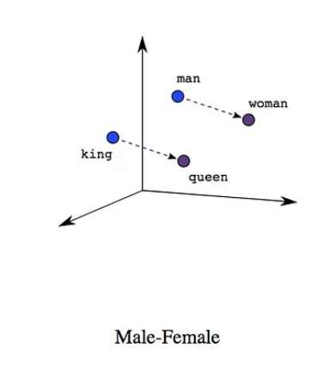
Review: Embedding
What does Embedding look like?
An n-dimensional vector with elements usually ranging from -1 to 1
E.g. [0.85 -0.24 0.56 0.73]
What does Embedding represent?
Objects: An Image, An Audio, A word, A sentence
Goal: Words in similar meaning should be placed close to each other.
women - man = queen - king
Notes:
maybe start with “why do we need embeddings?”
can use the example of RAG?
note: “close to each other” means they have appeared together regularly in the corpus.
(Connor may have slides??)

Slide 5
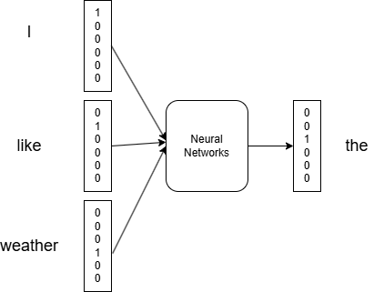

Review: Embedding Cont.
How to get text embeddings?
Word2vec, BERT etc.
Word2vec
Continuous Bag-of-Words (CBOW): predicts the target-word based on its surrounding words.
Skipgram: Given a word, what words it is expected to be surrounded by.
Where does the embedding come from?
CBOW
Notes:
What does it mean?
It means that embeddings are trained to serve for a particular purpose. Such as predicting the next word.

Slide 6
Review: Embedding Cont.
Where does the embedding come from?
The Weights in last layer of Neural Networks!
Interpretation of weights:
Each word has a N dimension weights describing their N characteristics.
Example: Assume our corpus has M words in total.
Each word is represented as [0..1..0] vectors initially.
Inputs
Weights
Embedding
Like
x
[ 1 0 0 … 0]
=
[0.64 -0.78 … 0.23]
1 x M
M x N
1 x N
Notes:
Rework?

Slide 7
Embedding Takeaways
Embeddings are vector representing of objects (text or images) so that similar objects are close to each other.
In General, Large corpus and large data implies better embeddings.
Embeddings are available online (HuggingFace, nltk python library)
Self-training embeddings could be time and resource consuming
Dataset and Task during embedding training is important!!!
Carefully select available embeddings for your own use!!!
What business applications can embedding help with?
Notes:
Rework? (maybe more on embeddings than needed)
can be used
in a business setting: sentiment, clustering, customer service.
Simple example from GPT:
Cluster 0: Battery life is terrible.
Cluster 1: Love the sleek design!
Cluster 0: Battery doesn’t last more than a day.
Cluster 1: Stylish and comfortable to wear.
Cluster 0: Would love longer battery life.

Slide 8
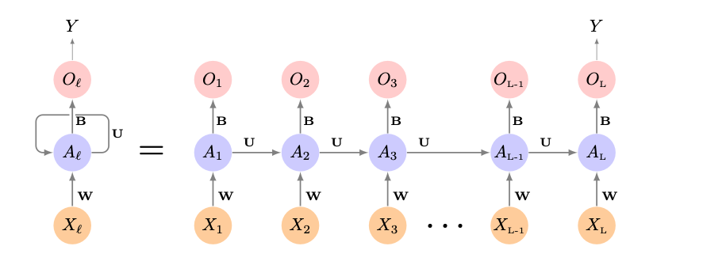
Review: Recurrent Neural Networks
What kind of data do we need？
Sequential data
What are the benefits of using RNN?
Small model size: same weights for each step
Process text in any length
Memorize previous information
What are the problems of using RNN?
Sequential computation: takes time and memory, cannot be parallelized
Information loss when sequences are too long
Notes:
Explain about Recurrent Neural Network.
When will you use it? Why would you use it.
Business Example
Set that up and go through the technical slides

Slide 9
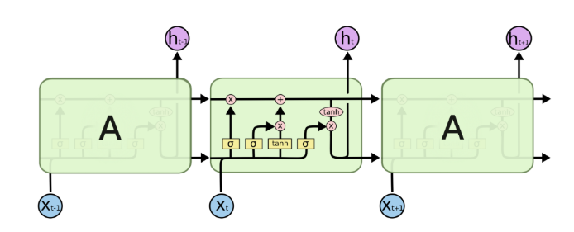
Review: Long Short-Term Memory (LSTM)
LSTM is an improvement to RNN. What did LSTM improve?
Better information memory: Add a “gate” to control memory information (what to keep, what to forget)
Is there any situation where company will use RNN instead of LSTM?
Limited Resources, Small model needed.

Slide 10
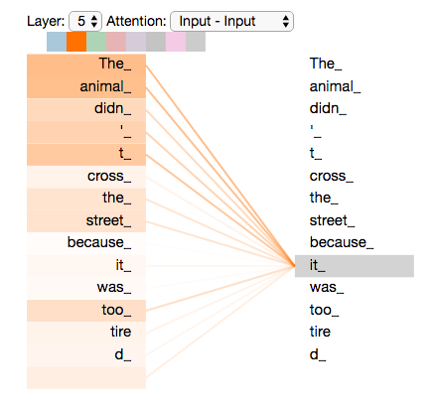
Review: Transformer
“The animal didn’t cross the street because it was too tired”
Attention Is All You Need [Vaswani et al 2017]
What are the improvement of Transformer?
Computation efficiency: Parallelizable
Learn semantic meaning better:
Attention mechanism
What are the problems of Transformer?
Computation complexity increases when sequences are long.
Fixed sequence length
Data Consumption
When will company use LSTM instead of Transformer?
Small Dataset
Extremely long sequence (>2000)

Slide 11
Review: Transformer
What does Transformer contains as function block?
Encoders: Convert Text into Embeddings.
Decoders: Convert Embeddings to Text.
I am a student
Encoders
Decoders
我是一名学生
What can these blocks do?
Encoder + Decoder: Translation Task
Encoder + Classifier: Classification Task. e.g. Spam Detection
Decoder: Generation Task. e.g. ChatGPT

Slide 12
Pre-training and Fine-tuning
Different stages of training:
Pre-training：
It uses a large dataset to learn general information
Self-supervised learning: predict the next word
Fine-tuning:
Align the pre-trained model with user needs
Take pretrained model to further train on a specific task with a smaller dataset. (Downstreaming Tasks)
What are the cases to train Pre-training Models or directly use existing pre-training models?
Use: Exactly the same task as the training task
Use: General Generation Task, such as using ChatGPT
Train: Large Dataset, rich resources
What are the cases to apply fine-tuning techniques?
A similar task but slightly different: analysis on reviews on 1-10 scale when the pre-training models are on 1-5 scales.
Small Dataset
Notes:
When to use fine-tuning?
If the model needs to learn new behavior, tone, or format consistently.
if you need to add subject matter expertise to GPT (for instance, you have many human labelled examples)
DIscussion ->

Slide 13

ChatGPT: Why ChatGPT is called ChatGPT
ChatGPT is built on Generative Pretrained Transformer (GPT)
GPT only contains a decoder. (117M parameters) [Radford et al 2018]
Trained on Books Corpus (4.6GB text)
What Happened: Pre-trained Models are good at Downstreaming Tasks
GPT-2 (1.5B parameters) (1.5B) [Radford et al 2019]
Trained with more data (40GB) Internet text data (WebText) with quality control: at least 3 upvotes on Reddit
What Happened: Emergent Zero-Shot Learning
GPT-3 (175B parameters) (175B) [Brown et al 2020]
Trained with even more data (600 GB)
What Happened: In-Context Learning
Notes:
Maybe reframe this as “LLM innovations” instead of building up GPT2, GPT 3…

Slide 14
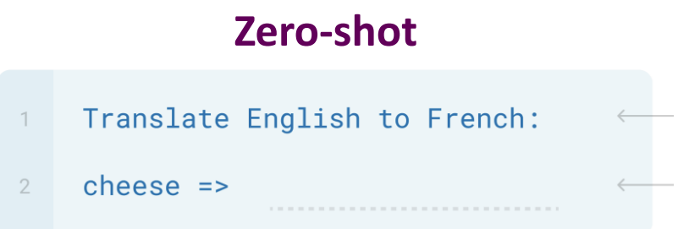
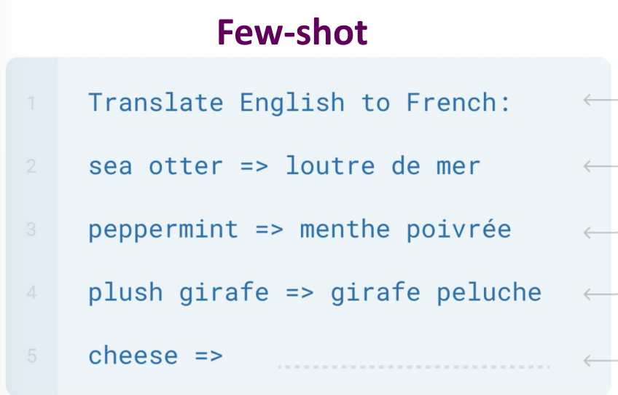
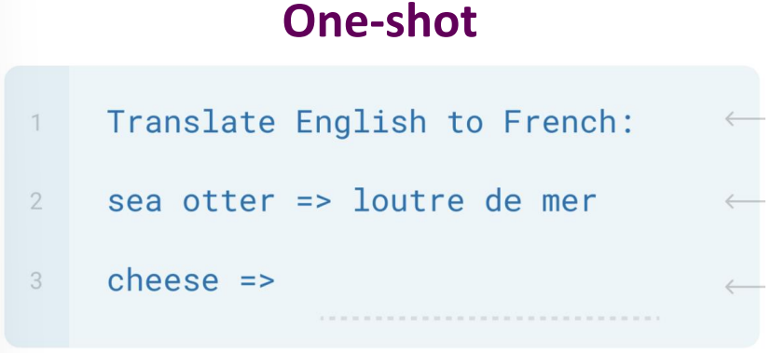
ChatGPT: Why ChatGPT is called ChatGPT
Zero-Shot Learning: The ability to do many tasks without the need of example or fine-tuning in terms of gradient updates.
One-shot Learning:The ability to learn to solve a task by observing only one example before real task.
Few-shot Learning (In-context Learning): The ability to learn to solve a task by observing many examples before real task.
No Fine Tuning, No gradient updates
Notes:
Fewer words or shrink it. Put Zeroshot at the main screen.

Slide 15
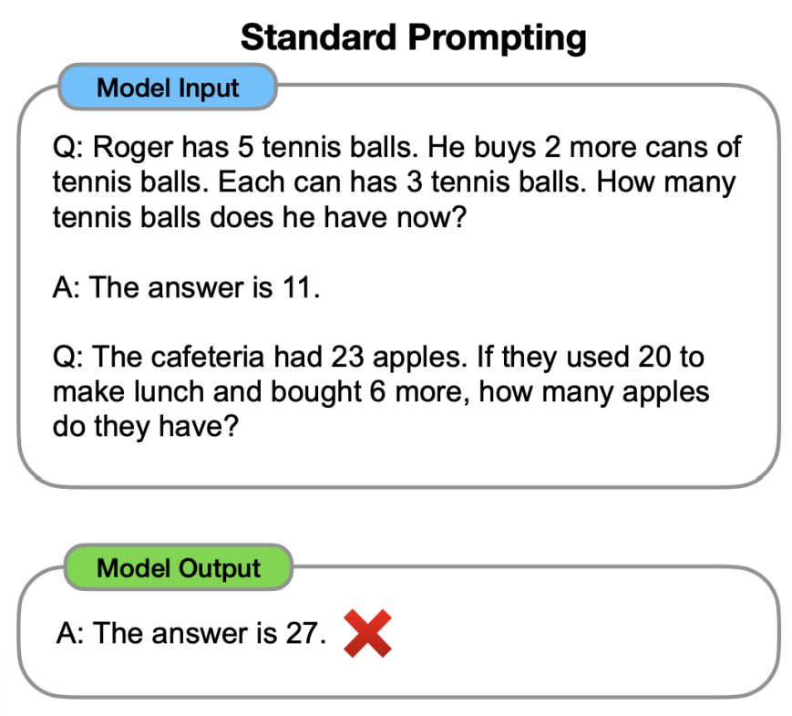
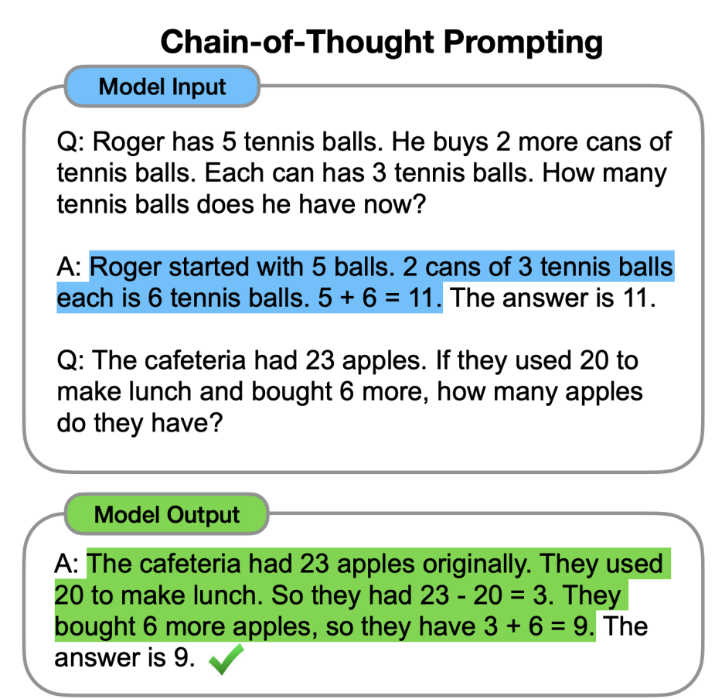
ChatGPT: Prompting Technique
Problems:
Some tasks are hard for Large Models to learn through prompting, such as math
Solution: ` [Wei et al 2022]

Slide 16
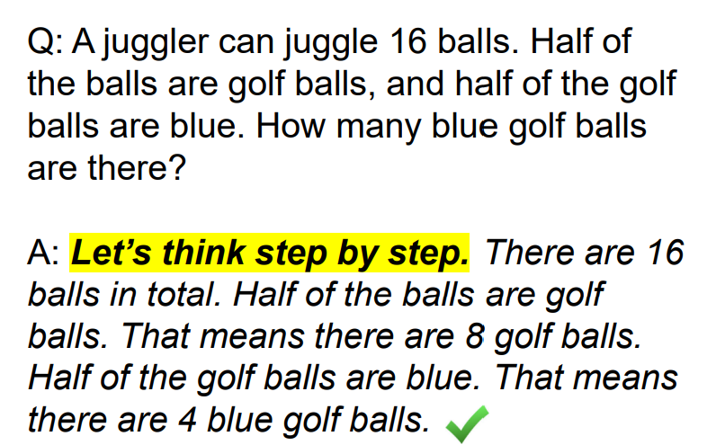
ChatGPT: Prompting Technique Cont.
Chain-of-thought Prompting (CoT) [Wei et al 2022]
Do we really need to teach model how to reason?
The answer is No!
Zero-shot CoT [Kojima et al 2022]
Other useful prompts:
Let’s work this out in a step way to be sure we have the right answer.
Let’s think step by step
First
Let’s think about this logically
Let’s solve this problem by splitting it into steps
…
Maybe use Google Code header to generate more “professional code”?

Slide 17




MoE: Model of Experts
Large Model
Small Models
Translate into Chinese: The government announced a new policy to support small businesses during the economic downturn.
hmmm, it’s about Chinese, English, Translation, so let’s activate related models
Gate
Chinese Semantic Model
English Semantic Model
Translation Model
Expert Models

Slide 18



ChatGPT: RLHF
GPT models predict the next possible word.
Is it what humans want?
Not Always.
Solution: Involve human judgement - Reinforcement Learning from Human Feedback (RLHF)
Agent
Reward: Human Feedback/ Reward Model
State:
Prompt + Generation
Actions:
ChatGPT Response
Environment
Prompt Task
Reward Model

Slide 19
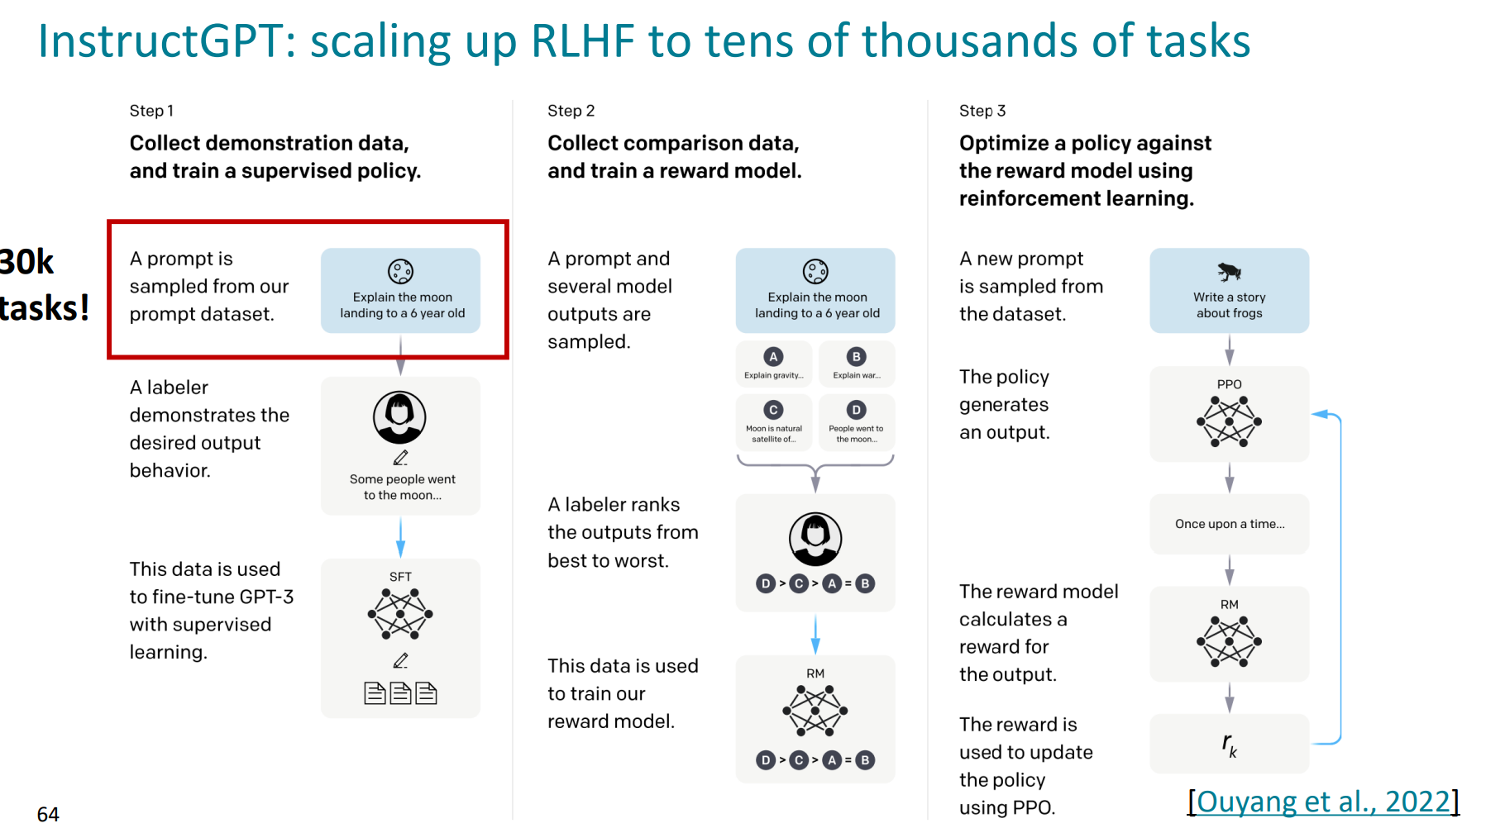
ChatGPT: RLHF

Slide 20
ChatGPT
Version | Architecture | Training Dataset | Technique | Cost (4/25) (1M Tokens) | Properties
Pre-ChatGPT (June 2018) | GPT (12-layer Transformer, 117M) | BooksCorpus | NA |  | Introduced “unsupervised pretraining + supervised finetuning”
Pre-ChatGPT (Nov 2019) | GPT-2(up to 1.5B parameters) | WebText | NA |  | zero-shot learning
Pre-ChatGPT (June 2020) | GPT-3 (175B) | More Data | NA |  | one-shot / few-shot learning
GPT-3.5 (Dec 2022) | GPT-3.5 | Mixture | InstructGPT | $0.50 | Reasoning, Coherence
GPT-4 (Mar, 2023) | GPT-4 (1T) | Mixture | CoT MoE | $30 | Stronger Reasoning
GPT-4turbo (Nov, 2023) | GPT-4 | Mixture | NA | $10 | Faster, Cheaper, Longer Context
GPT-4o (May, 2024) | Multimodal | Mixture with Images, Audios | NA | $2.50 | Good for real-time assistance
GPT 4o-mini | Multimodal | Mixture with Images, Audios | NA | $0.15 | Smaller, cheaper 4o
o1 |  | Mixture with Images, Audios | RLHF Chain-of-Thought | $15 | Complex reasoning, deep thought
Notes:
Dont spend a lot of time on this…main points are rapid development, and many different available options…need to carefully choose for function and price.

Slide 21
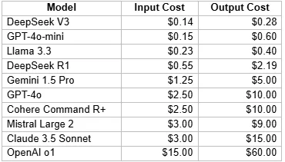
DeepSeek
Why Deepseek became so popular now?
Cheaper but similar performance to GPT4
From https://docsbot.ai/
What techniques are used?
Low-bit
4-bit, 8-bit
Light Start
Context windows, initial models, attentions, sparse MoE activation
Notes:
what was revolutionary about DeepSeek? Equal power at lower cost. how did they do this?
Innovation of DeepSeek
Message:
How are they going to what to use in the situation.

Slide 22
thank you.

